Slide 1


CS-446: Information Systems Security
Lecture # 18: Malicious Software and Botnets
Prof. Dr. Sufian Hameed
Department of Computer Science
FAST-NUCES

Slide 2
Overview
Introduction
Malicious Software
Botnets
Botnets detection and Rootkits

Slide 3
Lets start with a story
Takeover of Torpig Bot by security researchers from University of California, Santa Barbara
Notes:
Lorenzo Cavallaro was a postdoc researcher at UCSB when they encounter a unique challenge of actually taking over a bot.

Slide 4


Slide 5
The Botnet Threat
A network of compromised machines (bots) controlled by a botmaster
Responsible for (non-exhaustive list):
Large-scale network probing (i.e., scanning activities)
Launching Distributed Denial of Service (DDoS) attacks
Sending large-scale unsolicited emails (SPAM)
Click-fraud campaign
Information theft
Shift from a for-fun activity towards a profit-oriented business

Slide 6
The Torpig Botnet
Trojan horse
Distributed via the Mebroot “malware platform” as DLL
Injects itself into 29 different applications
Steals sensitive information (e.g., passwords, SSN, credit card numbers)
HTTP injection for phishing
Uses “encrypted” HTTP as Command & Control (C&C) protocol
Uses a resilient approach (domain flux) to contact a C&C server
Mebroot
Sophisticated master boot record based Rootkit
Spreads via drive-by downloads (unintended downloads)
Notes:
Trojan horse looks like a legitimate software but it hides malicious activity

Slide 7
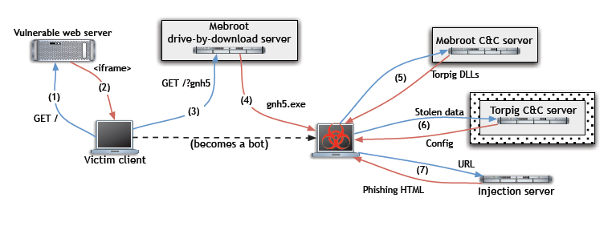
The Torpig Botnet

Slide 8
Data Collection Principles
Principle 1: the hijacked botnet should be operated so that any harm and/or damage to victims and targets of attacks would be minimized
Always responded with okn message
Never sent new/blank configuration file
Principle 2: the sinkholed botnet (bot manage by good guys) should collect enough information to enable notification and remediation of affected parties
Worked with law enforcement (FBI and DoD Cybercrime units)
Worked with bank security officers
Worked with ISPs
Notes:
After taking over the botnet they follow two basic operations

Slide 9
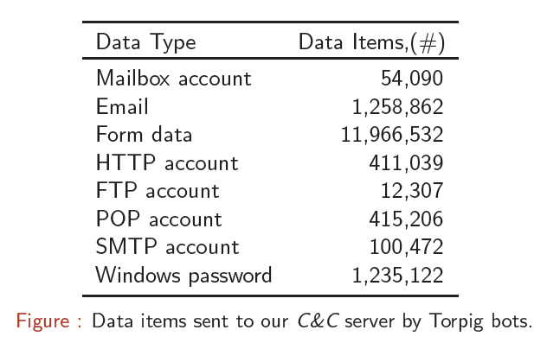
Data Collection
Observations:
Weak passwords
Credential reuse
Enables for more successful social engineering attacks

Slide 10
Threats (Theft of Financial Information)
8,310 unique accounts from 410 financial institutions
Top 5: PayPal (1,770), Poste Italiane, Capital One, E*Trade, Chase
38% of credentials stolen from browsers password manager
1,660 credit cards
Top 3: Visa (1,056), Mastercard, American Express, Maestro, Discover
US (49%), Italy (12%), Spain (8%)
Typically, one CC per victim, but there are exceptions

Slide 11
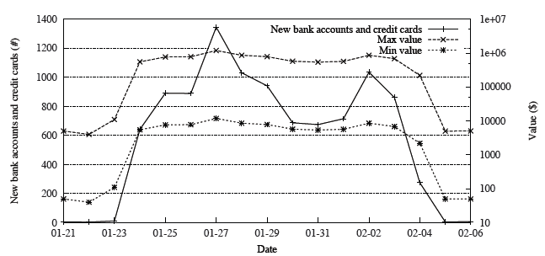
Value of Financial Information
In a 2008 report on the underground economy, Symantec estimates
Value of a stolen credit card details at $.10 to $25.00
Similarly, bank accounts at $10.00 to $1,000.00
Using such values, 10 days of Torpig data valued at $83K to $8.3M

Slide 12
Lessons Learned

Slide 13
Lessons Learned
Most security threats start from the web
A malicious web page leverages a defect in a program to gain arbitrary code execution
The exploit downloads and installs a malware sample, that infects the victim

Slide 14
Malicious Software

Slide 15
Malicious Software
(Malware) refers to any unwanted software and executable code that is used to perform an unauthorized, often harmful, action on a computing device. It is an umbrella-term for various types of harmful software, including viruses, worms, Trojans, rootkits, and botnets.

Slide 16
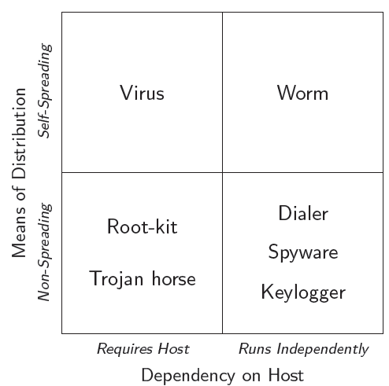
Taxonomy I

Slide 17
Taxonomy II
Virus
Self-replicating
Needs a host to infect
Boot (Brain virus), overwrite, parasitic, cavity, entry point obfuscation, code integration (W95/Zmist virus)
Worm
Self-replicating, spreads (autonomously) over network
Exploits vulnerabilities affecting a large number of hosts
Sends itself via email
e.g., Internet worm, Netsky, Sobig, Code Red, Blaster, Slammer

Slide 18
Taxonomy III
Trojan horse
Malicious program disguised as a legitimate software
Many dierent malicious actions
Spy on sensitive user data
Hide presence (e.g., root-kit)
Allow remote access (e.g., Back Orice, NetBus)
Root-kit
Used to keep access to a compromised system
Usually hides files, processes, network connections
User- and kernel-level (very sophisticated and can hide drivers)

Slide 19
Fighting Malware I
Foremost Goals
Understand malware behaviors
to (automatically) identify and classify families of malware
(to) automatically generate effective malware detection models
Collect malware samples
How about infection strategies?
Analyze samples
Static analysis
Studying a program's properties without executing it
Reverse engineering may be hampered (e.g., obfuscation, encryption)
Dynamic analysis
Studying a program's properties by executing it
Environment-limited analysis

Slide 20
Fighting Malware II
Extract (and generalize) malicious behavior
Host
Network
Generate and deploy detection models
Hard Problems
Lack of general definition of malicious behavior
Cat-and-mouse game: attackers have much freedom
Victims often (unwittingly) help attackers

Slide 21
Botnets

Slide 22
Botnets I
Bot
Autonomous programs performing tasks
More recent trend in malicious development
Benign bots
First bots were programs used for Internet Relay Chat (IRC)
React to events in IRC channels
Typically offer useful services
Early definition of bot
An IRC user who is actually a program. On IRC, typically the
robot provides some useful service. Examples are NickServ,
which tries to prevent random users from adopting nicks already
claimed by others.

Slide 23
Botnets II
Eggdrop bot (1993)
Used to manage IRC chat channels when the operator was away
Still maintained, see http://eggheads.org
Malicious IRC bots started to evolve
Takeover wars to control certain IRC channels
Trash talking (flooding)
Also involved in Denial of Service (DoS) to force IRC net split (disconnection from previous connection)
IRC proxies to hide attackers' origin
A number of parallel, malicious developments

Slide 24
History I
How did we get here?
Early 1990s: IRC bots
Automated management of IRC channels
1999 --- 2000: Distributed DoS tools (distribution)
Trinoo, TFN2k, Stacheldraht
1999 --- 2000: Trojan Horse (remote control)
BackOrice, BackOrice2k, SubSeven
2001 --- today: Worms (spreading)
Code Red, Blaster, Sasser

Slide 25
History II
Bots today
Malware (backdoor, Trojan) running on compromised machines
Incorporates different modules to carry out malicious tasks (spamming, DoS, . . . )
Remote controlled by criminal entity (called bot master or bot herder)
Bots are incorporated in network of compromised machines
Botnets (sizes up to hundreds of thousands of infected machines)
Botnets
Main vehicle for carrying out criminal activities
Financial motivation

Slide 26
Botnets
How do botnets get created?
Infection and spreading
How are bots (and botnets) controlled?
Command and control channel (C&C), robustness features (e.g., fast flux, domain flux, push/pull/P2P)
What are botnets used for?
Criminal applications
How can we mitigate the problem?

Slide 27
Creation
Host infected by one of
Network worm (vulnerabilities)
Email attachment
Trojan version of program (ever heard of P2P?)
Drive-by-downloads (malicious web sites)
Existing backdoor (from previous infection)
Specialized services (PPI, Exploit-as-a-Service)

Slide 28
Drive-By Downloads
Malicious scripts
Injected into legitimate sites (e.g., via SQL injection)
Hosted on malicious sites (URLs distributed via spam)
Embedded into ads
Drive-by downloads
Attacks against web browser and/or vulnerable plug-ins
Typically launched via client-side scripts (JavaScript, VBScript)
Redirection
Landing page redirects to malicious site (e.g., via iframe)
Makes management easier
Customize exploits (browser version), serve each IP only once

Slide 29
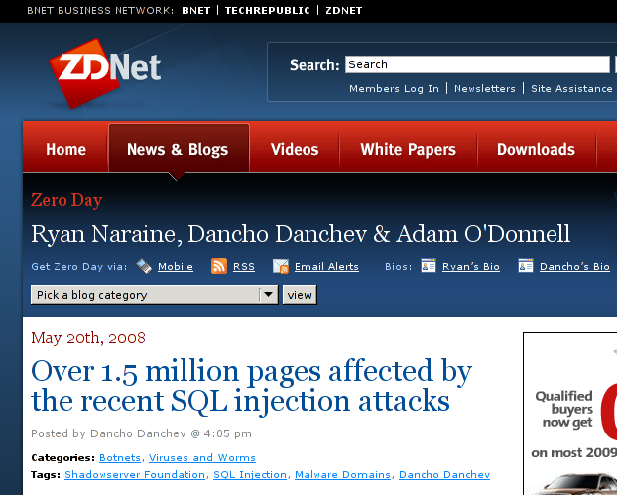
Propagation Technique: Remote exploit + drive-by-download

Slide 30

Propagation Technique: Remote exploit + drive-by-download

Slide 31
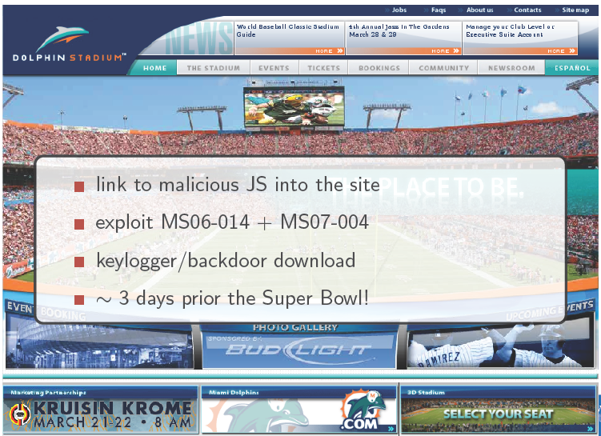
Propagation Technique: Remote exploit + drive-by-download
Notes:
Now a days there is search engine optimization that lure users from malicious site

Slide 32
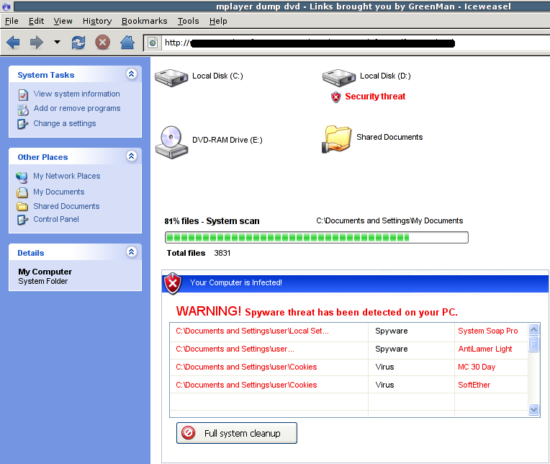
Propagation Techniques: Rogue Antivirus

Slide 33
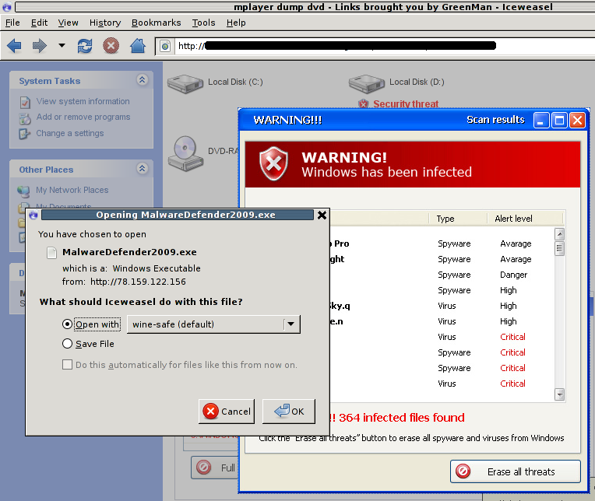
Propagation Techniques: Rogue Antivirus

Slide 34
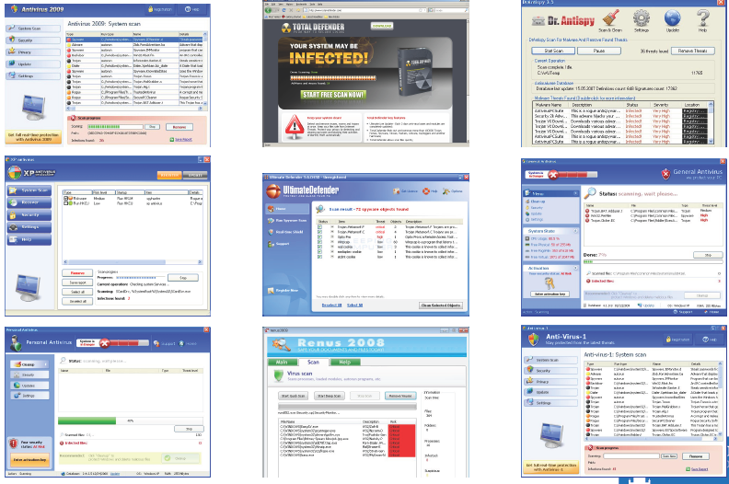
Propagation Techniques: Rogue Antivirus

Slide 35
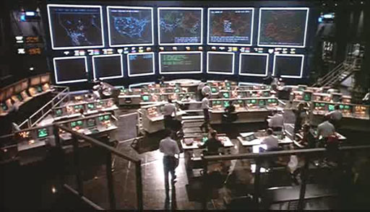
Command & Control

Slide 36
Command & Control
Centralized control
IRC Commands published in IRC channels
(irc.krienaicw.pl #djdjeiu)
HTTP Commands published in web pages
(http://www.myspace.com/angelairiejs/)
Distributed control
P2P Commands and/or “commander” address published in the P2P network (more resilient to take down)
Push vs. Pull
Push The bot silently waits for commands from the “commander"
Pull The bot repeatedly queries the “commander” to see if there is a
new work to do

Slide 37
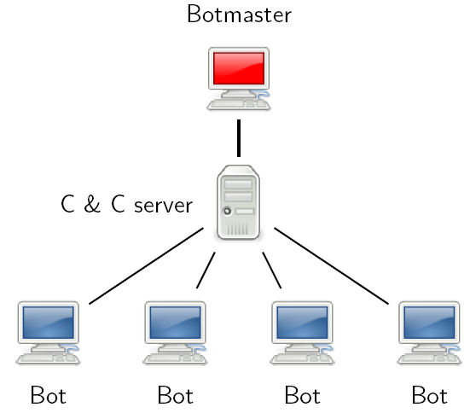
IRC based botnet

Slide 38
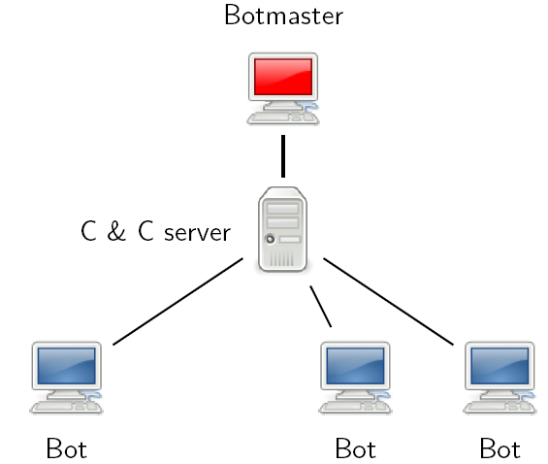
IRC based botnet
The bots continuously (re)connect to the C&C server

Slide 39
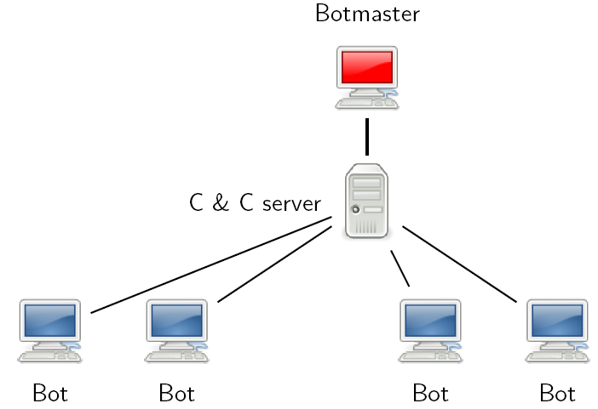
IRC based botnet
The bots continuously (re)connect to the C&C server

Slide 40
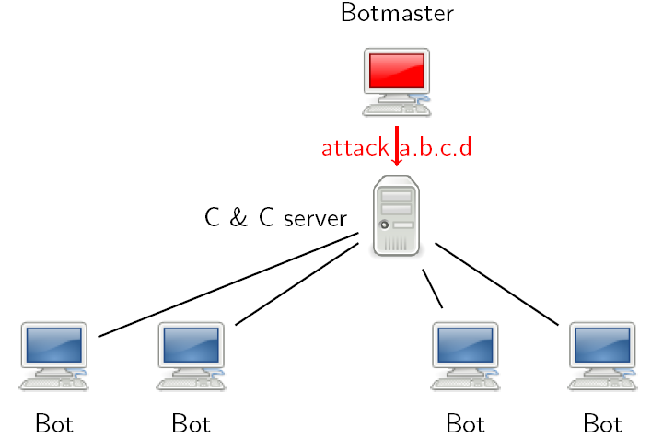
IRC based botnet
The botmaster sends a command to the C&C server

Slide 41
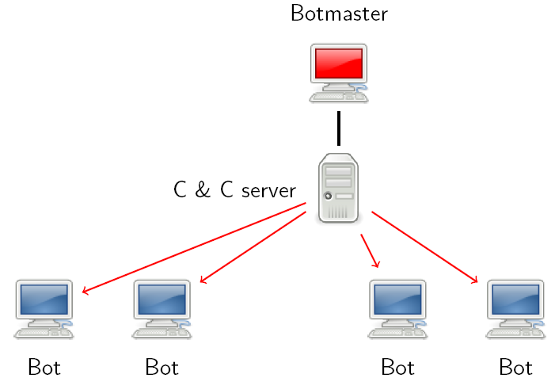
IRC based botnet
The C&C server forwards the command to all connected bots

Slide 42
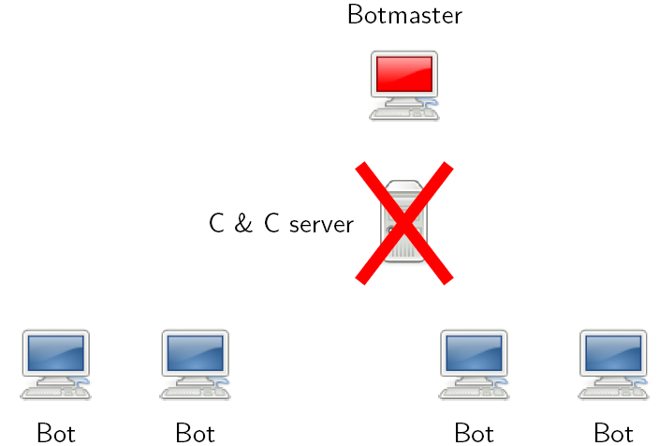
IRC based botnet
If the C&C server is isolated, the botmaster loses control of all the bots

Slide 43
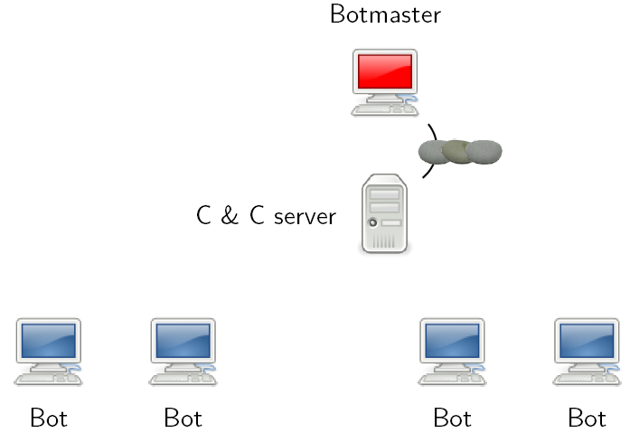
IRC based botnet
It could be very difficult to identify the botmaster! (e.g., coffee shops or a chain of compromised machines)

Slide 44
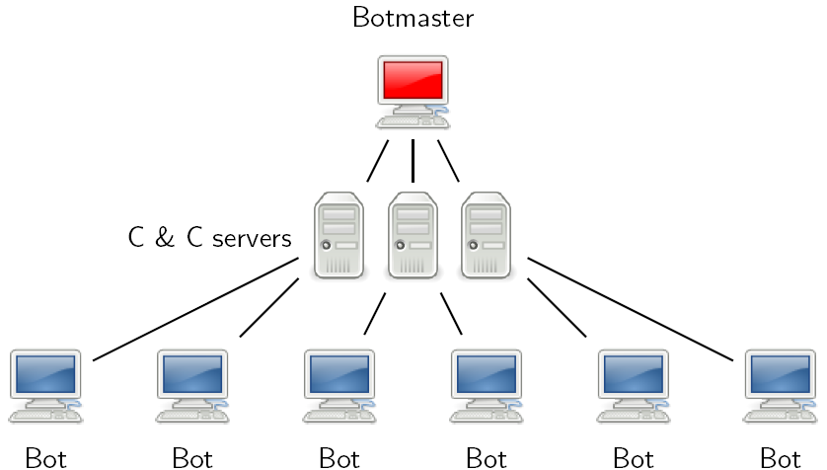
IRC based botnet
Multiple C&C servers can be used simultaneously

Slide 45
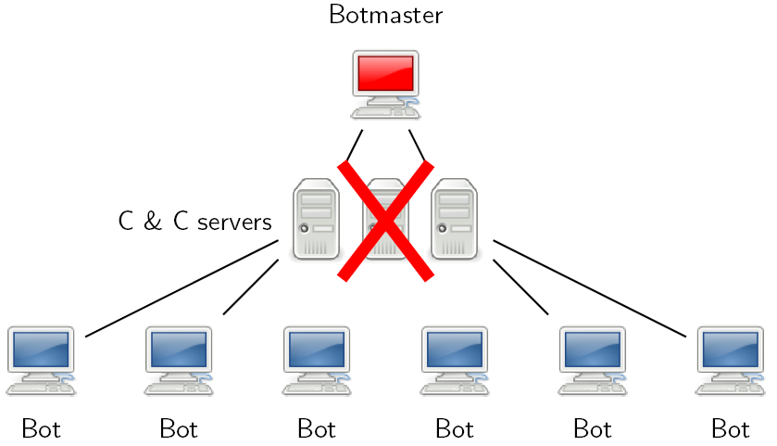
IRC based botnet
When a C&C server is isolated the bots connect automatically to the others

Slide 46
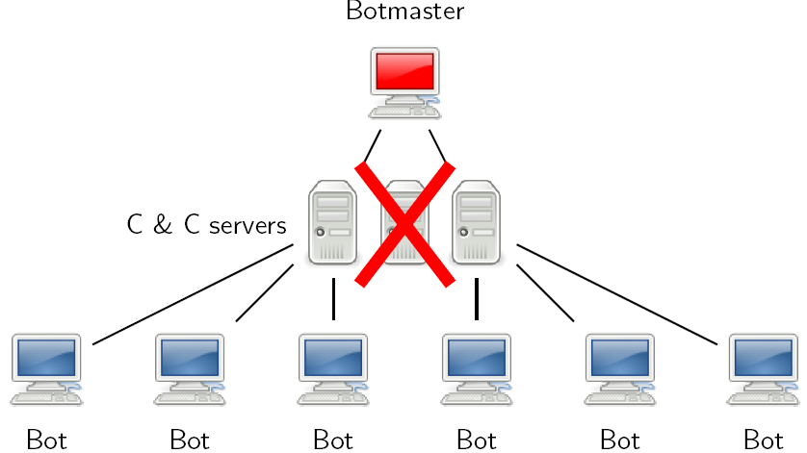
IRC based botnet
The use of multiple C&C servers increases the lifetime of the botnet

Slide 47
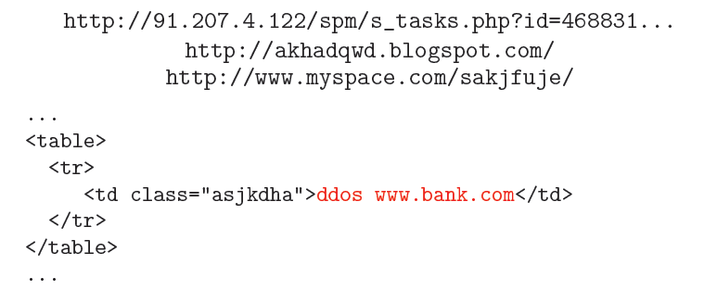
HTTP based botnet
Very similar to botnet based on IRC
C&C in \pull" mode
C&C trace is difficult to identify
Difficult to block at network level (e.g., firewall)
Difficult to block at DNS level (e.g., domains blacklisting)

Slide 48
Dynamic rendez-vous points
How does a bot locate the C&C server?
Hardcoded IP address
FustFlux: Hardcoded FQDN or dynamically generated FQDNs (1 FQDN → 1 or more IP addresses)
DomainFlux: Hardcoded URL or dynamically generated URLs (generated different domains as time passes by)
Search keys in the P2P network
Notes:
numerous IP addresses associated with a single fully qualified domain name, where the IP addresses are swapped in and out with extremely high frequency, through changing DNS records.
Rendezvous = A meeting at a prearranged time and place

Slide 49
Preventing the rendez-vous
Network level ACLs
DNS ACLs
HTTP ACLs
DDoS against the C&C server?
It is possible to perform clustering to determine that a domain is generated by a DomainFlux

Slide 50
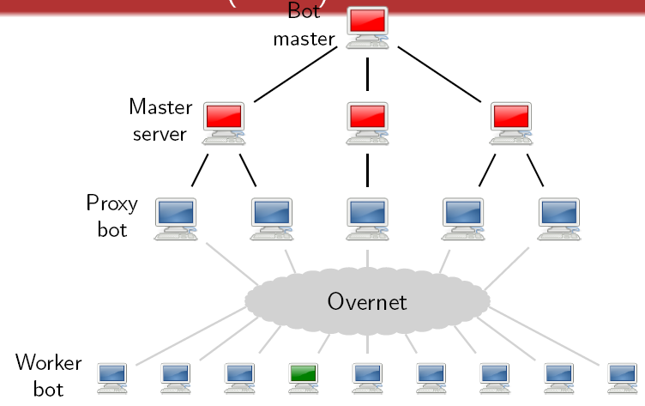
P2P based botnet (Storm)
P2P protocol based on Overnet (derived from Kadmelia)

Slide 51
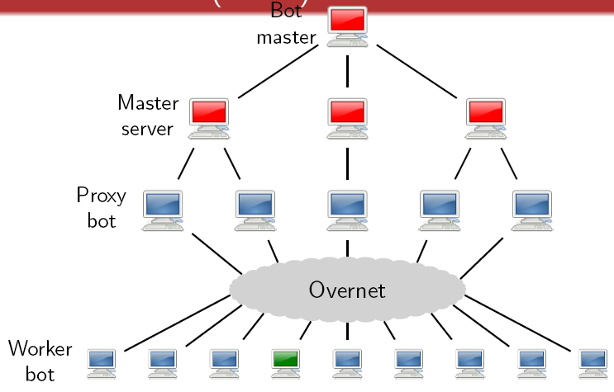
P2P based botnet (Storm)
Search for keys in the P2P network to locate the proxies (keys are dynamic and published by the proxies through the P2P)

Slide 52
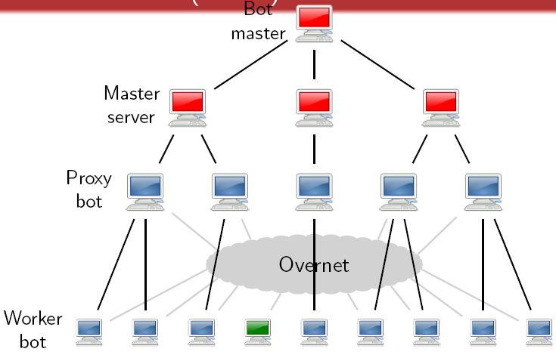
P2P based botnet (Storm)
Connect to the proxy and wait for commands (each key is associated with the IP and the port of a new proxy)

Slide 53
P2P based botnet (Storm)
The worker bot connects to the proxy, authenticates itself and waits for commands

Slide 54
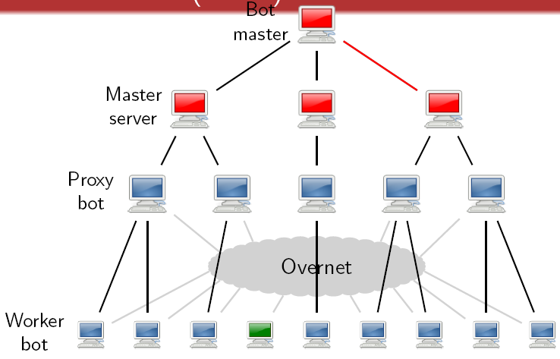
P2P based botnet (Storm)
The proxy forwards command from the master to the workers and vice versa

Slide 55
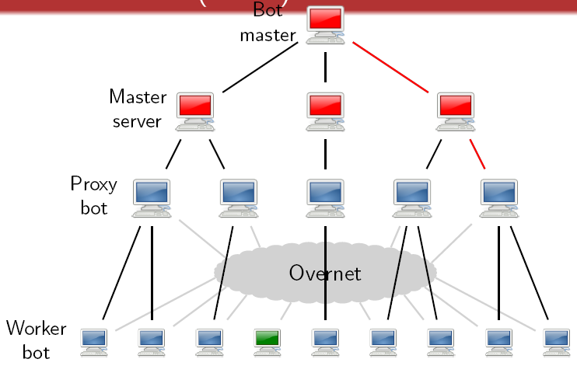
P2P based botnet (Storm)
The proxy forwards command from the master to the workers and vice versa

Slide 56
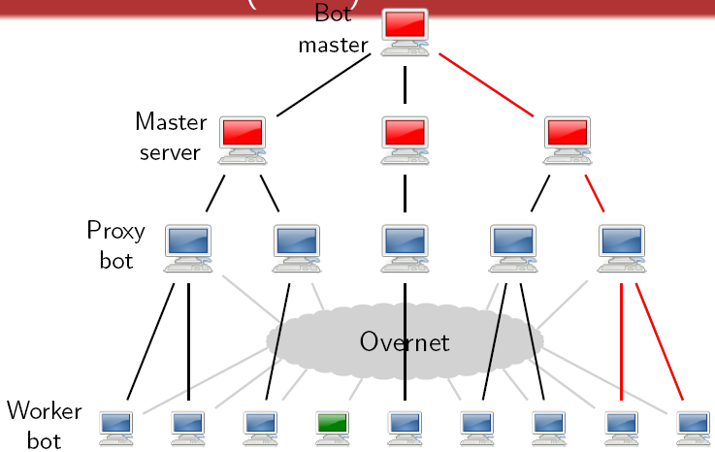
P2P based botnet (Storm)
The proxy forwards command from the master to the workers and vice versa

Slide 57
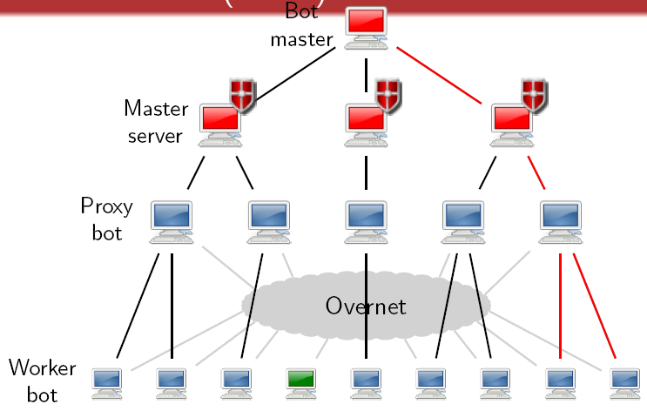
P2P based botnet (Storm)
Master servers are controlled directed by the botmaster and are hosted on bullet-proof hosts

Slide 58
P2P based botnet (Storm)
Workers with best resources are elected to proxies

Slide 59
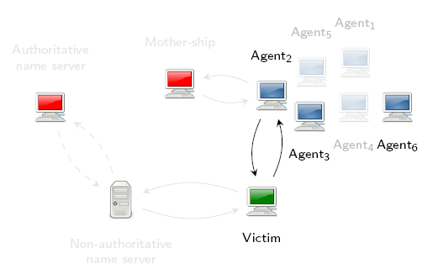
Fast-flux service network
Off line, disinfected, or problematic agents are replaced with others
The botnet is typically composed of millions of agents
The identity of the code components of the infrastructure is well protected
Multiple domains are used by the same botnet (it is not sufficient to shut down a domain)

Slide 60
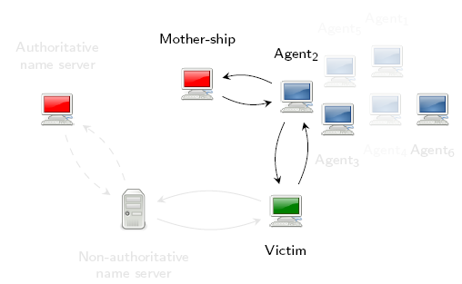
Fast-flux service network
Off line, disinfected, or problematic agents are replaced with others
The botnet is typically composed of millions of agents
The identity of the code components of the infrastructure is well protected
Multiple domains are used by the same botnet (it is not sufficient to shut down a domain)

Slide 61
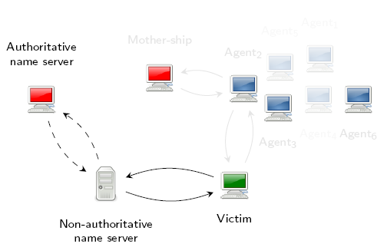
Fast-flux service network
Off line, disinfected, or problematic agents are replaced with others
The botnet is typically composed of millions of agents
The identity of the code components of the infrastructure is well protected
Multiple domains are used by the same botnet (it is not sufficient to shut down a domain)

Slide 62
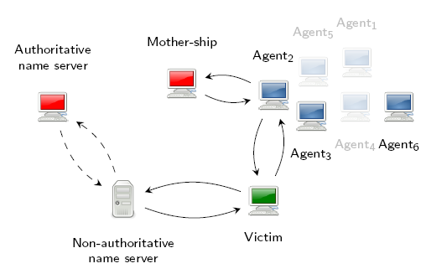
Fast-flux service network
Off line, disinfected, or problematic agents are replaced with others
The botnet is typically composed of millions of agents
The identity of the code components of the infrastructure is well protected
Multiple domains are used by the same botnet (it is not sufficient to shut down a domain)

Slide 63
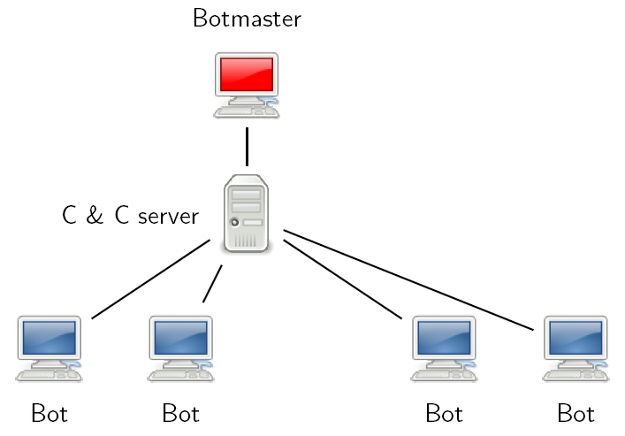
Infiltrate a botnet (HTTP C&C)

Slide 64
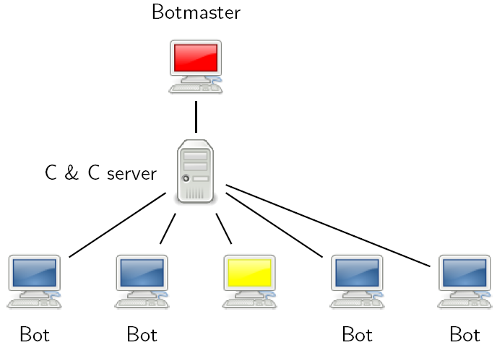
Infiltrate a botnet (HTTP C&C)
The infiltrator connects to C&C server as a normal bot and can see all the bots connected

Slide 65
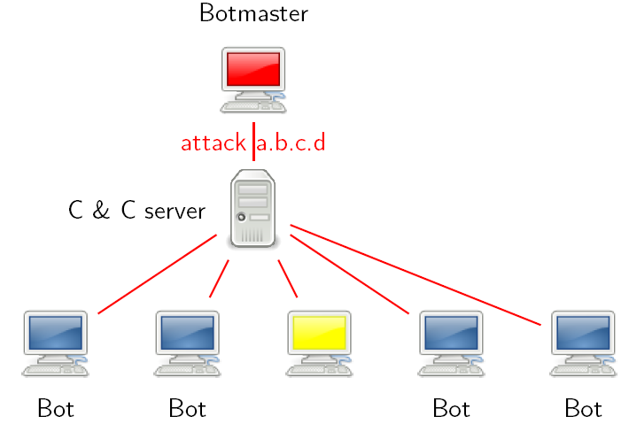
Infiltrate a botnet (HTTP C&C)
The infiltrator receives commands from the botmaster as the other bots

Slide 66
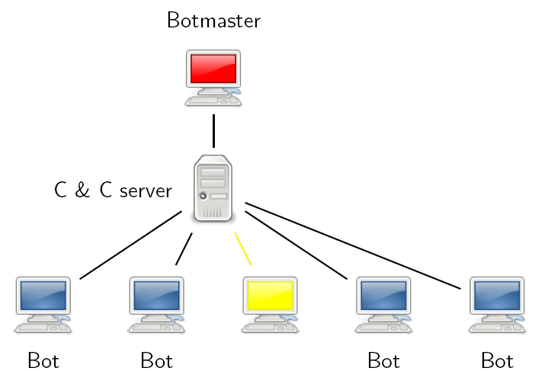
Infiltrate a botnet (HTTP C&C)
The infiltrator has the ability to send commands to other bots

Slide 67
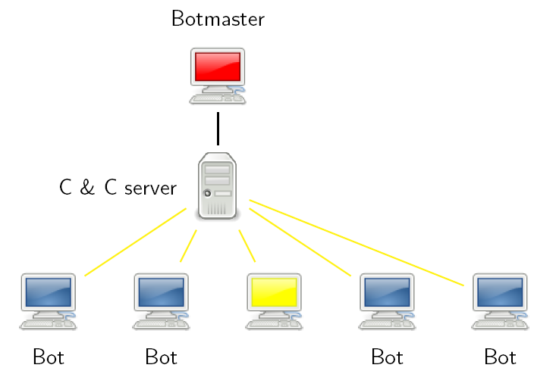
Infiltrate a botnet (HTTP C&C)
The infiltrator has the ability to send commands to other bots

Slide 68
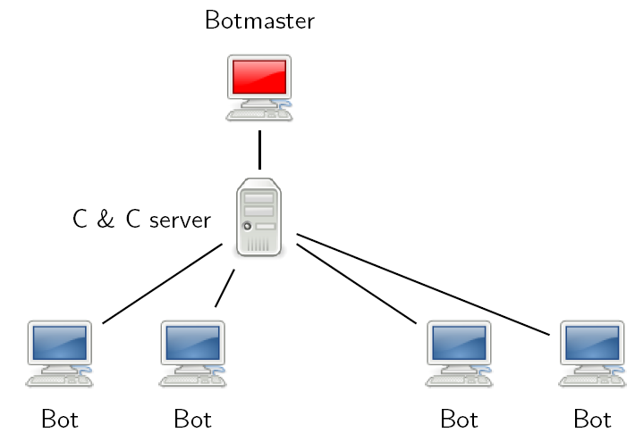
Infiltrate a botnet (HTTP C&C)

Slide 69
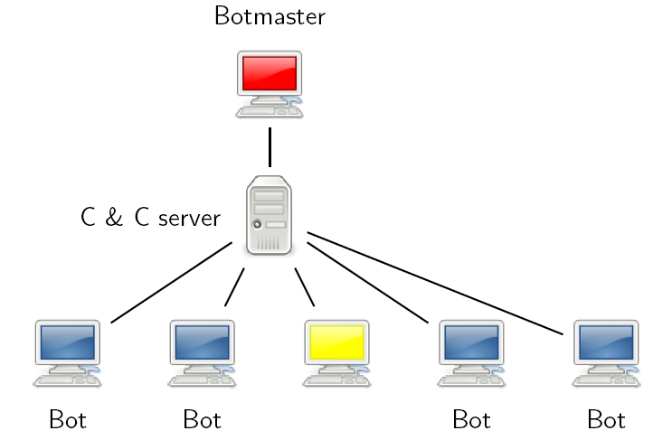
Infiltrate a botnet (HTTP C&C)
The infiltrator connects to the C&C server as a normal bot but he cannot see the other bots connected (C&C pull)

Slide 70
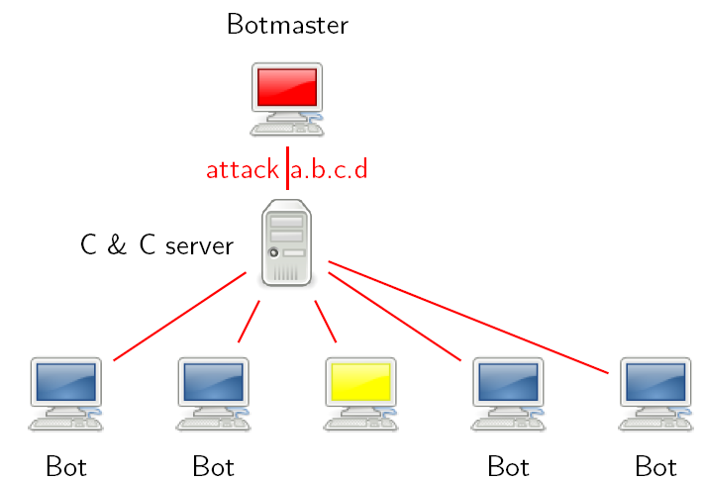
Infiltrate a botnet (HTTP C&C)
The infiltrator receives commands from the botmaster as the other bots

Slide 71
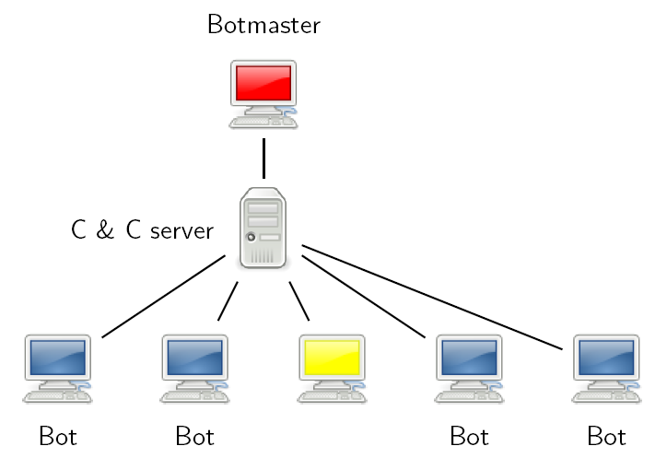
Infiltrate a botnet (HTTP C&C)
The infiltrator cannot send commands to other bots

Slide 72
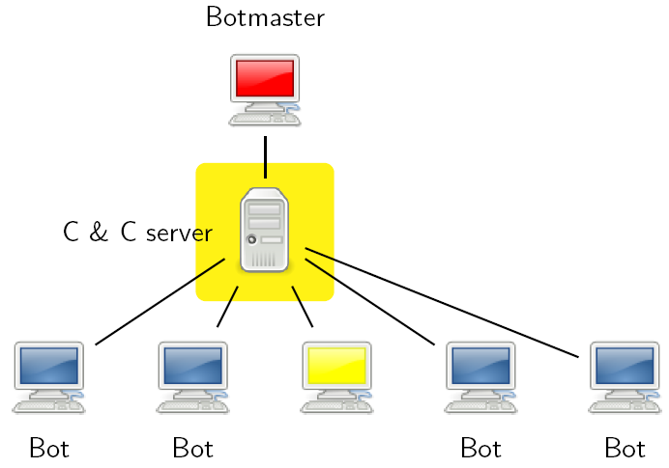
Infiltrate a botnet (HTTP C&C)
The server-side infiltrator instead can see the other bots and send them commands

Slide 73
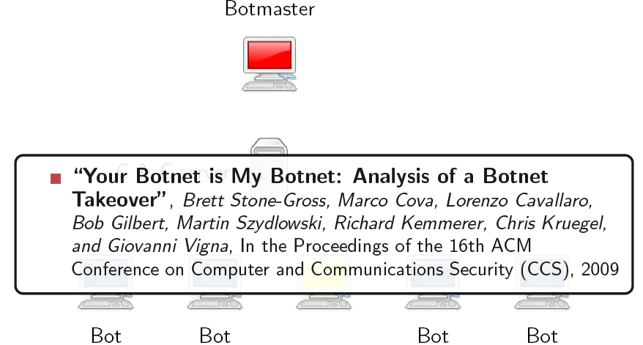
Infiltrate a botnet (HTTP C&C)

Slide 74
Rootkits (Hide Your Malware)

Slide 75
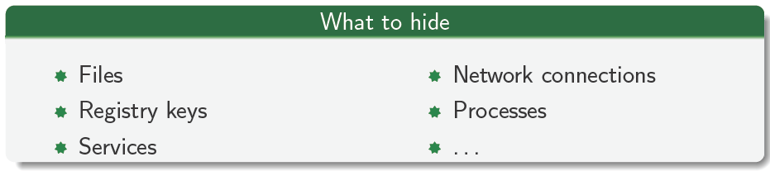
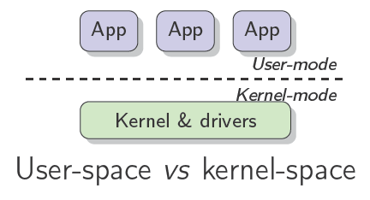
Rootkits
A rootkit is a tool used to hide, to the system administrator, the presence of a malware on the system

Slide 76
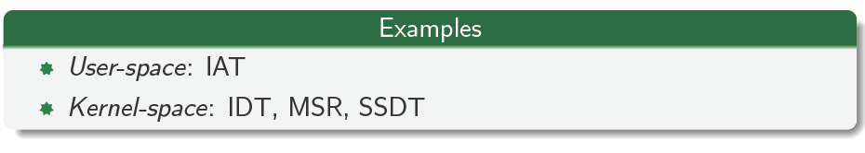
Root-kit: hooking
Hijack the flow of the execution by modifying a code pointer
Notes:
Input Address Table Equivalent to process linkage table and tells what external function this process is going to use.

Slide 77
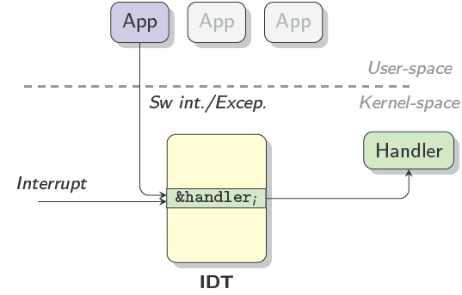
Root-kit: IDT hooking
Interrupt Descriptor Table
Interrupts and exceptions dispatching
Hijacking of 1+ handlers (e.g., 0x2e → KiSystemService)

Slide 78
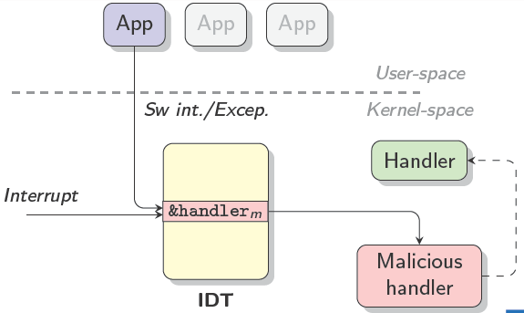
Root-kit: IDT hooking
Interrupt Descriptor Table
Interrupts and exceptions dispatching
Hijacking of 1+ handlers (e.g., 0x2e → KiSystemService)

Slide 79
Root-kit: IDT hooking
Interrupt Descriptor Table
Interrupts and exceptions dispatching
Hijacking of 1+ handlers (e.g., 0x2e → KiSystemService)
Problems
It is not possible to do filtering
System calls cannot be intercepted if sysenter/syscall are used
Easy to detect:
if (IDT[0x2e] != KiSystemService) then ...

Slide 80
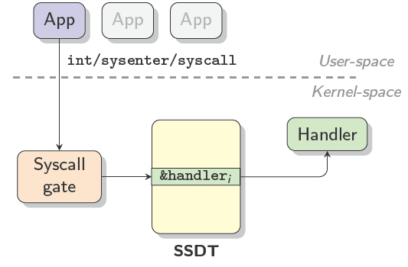
Root-kit: SSDT hooking
System Service Descriptor Table
System calls dispatching
Hijacking of 1+ descriptors (e.g., 0x74 → NtOpenFile)

Slide 81
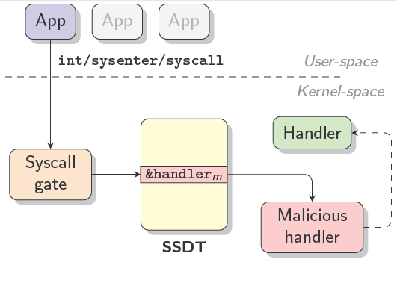
Root-kit: SSDT hooking
System Service Descriptor Table
System calls dispatching
Hijacking of 1+ descriptors (e.g., 0x74 → NtOpenFile)

Slide 82
Root-kit: SSDT hooking
System Service Descriptor Table
System calls dispatching
Hijacking of 1+ descriptors (e.g., 0x74 → NtOpenFile)
Problems
Easy to detect:
if (SSDT[0x74] != NtOpenFile) then ...

Slide 83

Root-kit: run-time patching
It is possible to intercept the execution in multiple points
More difficult to detect (no common hooking point)
Notes:
Make it more interesting and harder you can actually place a hook in original handler.

Slide 84

Root-kit: run-time patching
It is possible to intercept the execution in multiple points
More difficult to detect (no common hooking point)

Slide 85

Root-kit: run-time patching
It is possible to intercept the execution in multiple points
More difficult to detect (no common hooking point)

Slide 86

Root-kit: run-time patching
It is possible to intercept the execution in multiple points
More difficult to detect (no common hooking point)

Slide 87

Root-kit: run-time patching
It is possible to intercept the execution in multiple points
More difficult to detect (no common hooking point)

Slide 88

Root-kit: run-time patching
It is possible to intercept the execution in multiple points
More difficult to detect (no common hooking point)

Slide 89

Root-kit: run-time patching
It is possible to intercept the execution in multiple points
More difficult to detect (no common hooking point)

Slide 90

Root-kit: run-time patching
It is possible to intercept the execution in multiple points
More difficult to detect (no common hooking point)

Slide 91

Root-kit: run-time patching
It is possible to intercept the execution in multiple points
More difficult to detect (no common hooking point)

Slide 92

Root-kit: run-time patching
It is possible to intercept the execution in multiple points
More difficult to detect (no common hooking point)

Slide 93

Root-kit: run-time patching
It is possible to intercept the execution in multiple points
More difficult to detect (no common hooking point)

Slide 94

Root-kit: Direct Kernel Object Manipulation (DKOM)
In memory alteration of a kernel structure
No hook or patch necessary
malware.exe disappears from the list of running processes
Scheduling is thread-based

Slide 95

Root-kit: Direct Kernel Object Manipulation (DKOM)
In memory alteration of a kernel structure
No hook or patch necessary

Slide 96

Root-kit: Direct Kernel Object Manipulation (DKOM)
In memory alteration of a kernel structure
No hook or patch necessary

Slide 97
Acknowledgements
Material in this lecture are taken from the slides prepared by:
Prof. Lorenzo Cavallaro (Information Security Group, Royal Holloway, University of London)

